Slide 1
MycroForest - Exploring the use of a microworld to teach about economic viability of climate aware forest management.
Gayathri Girish Nair Course: MSc. Computer Science
Notes:
This project is about exploring the use of a microworld to teach about economic viability of climate aware forest management.

Slide 2
Background
AREA OF INTEREST
Carbon emissions & climate change.
Role of forests as carbon sinks.
Teaching about challenges associated with staying climate aware while ensuring economic viability.
Notes:
Climate change, the role of forests as carbon sinks, and spreading awareness about challenges around combating climate change while maintaining economic viability comprise the premise of this project.

Slide 3
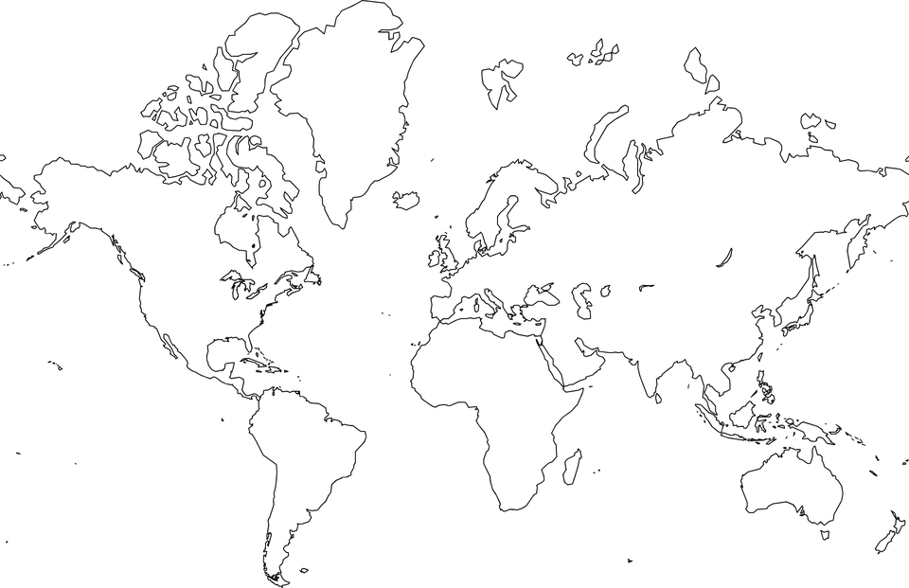
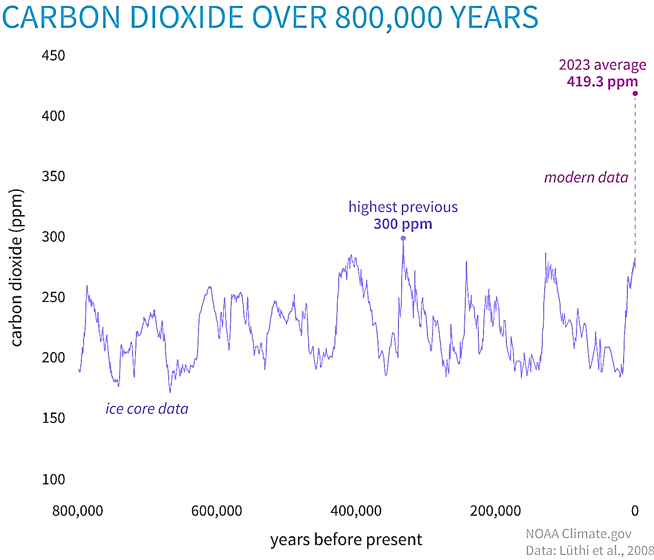



Background
USA 43°C (2024) [1]
https://www.climate.gov/media/15993
CO2: Important Greenhouse Gas
CLIMATE CHANGE
Extreme Climate: Heatwaves, Floods, Wildfires, Storms …
Disruption of Industry: Agriculture, Energy, Infrastructure …
Health Risks
NEED TO EDUCATE & INSPIRE RIGHT ACTION
MEXICO 51.9°C (2024) [2]
CO2 Conc. In Air = ↑ rapidly
EUROPE (2023) was the hottest year on record [3]
INDIA 50 °C (2024) [4]
Human Evolution
CO2 = 200 – 300 ppm
Now (22 June 2024)
CO2 = 427 ppm
Forests absorb 30% of global
emissions per year [6] but are fragile.
UN SDG GOAL 4
High demand for wood [7].
Pre-Industrial
CO2 = 280 ppm
Dangerous
CO2 = 430 ppm [5]
FORESTS
Notes:
This has been a year of unprecedented heat in many parts of the world. In addition to extreme weather and a negative impact on health of most living things, rapid climate change and global warming also disrupt our key industries.
As many of us are aware, carbon dioxide levels in the atmosphere is a key driver of global warming. CO2 is an important greenhouse gas. It helps keep the planet warm enough to make life possible. But in a very short time since the industrial revolution, human activities have released a very large amount of carbon into the air, and this has led to current atmospheric CO2 concentration being higher than ever before in over 800,000 years. In 2023, the concentration was 419.3 parts per million (ppm). On 22 June 2024, this was 427 ppm. It was predicted that if CO2 levels rose to 430 ppm, then we would experience widespread dangerous weather conditions and this year seems to reenforce this.
So, there is an urgent need for action against climate change. Forests are crucial to fighting climate change because they currently absorb around 30% of global emissions. But they are fragile. If enough of a forest is cleared, they begin to release more carbon than they absorb. Given our high demand for wood, this is already beginning to happen.
Thus, once again, spreading awareness about the importance of forests as carbon sinks is crucial to ensuring a sustainable future and is therefore in alliance with goal 4 "Quality Education" of the SDG set by the UN.

Slide 4
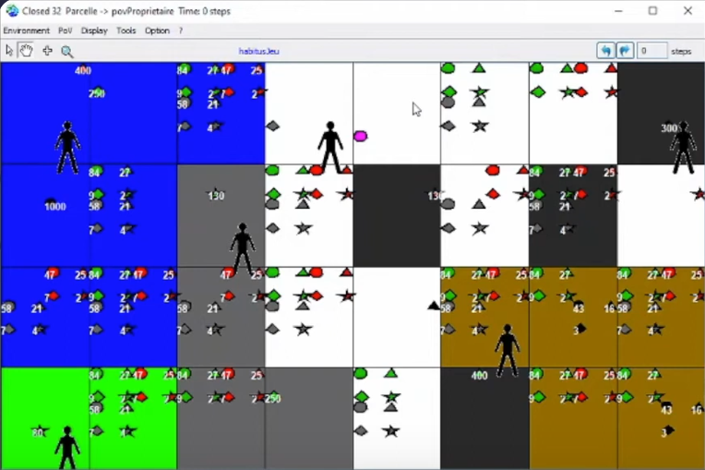
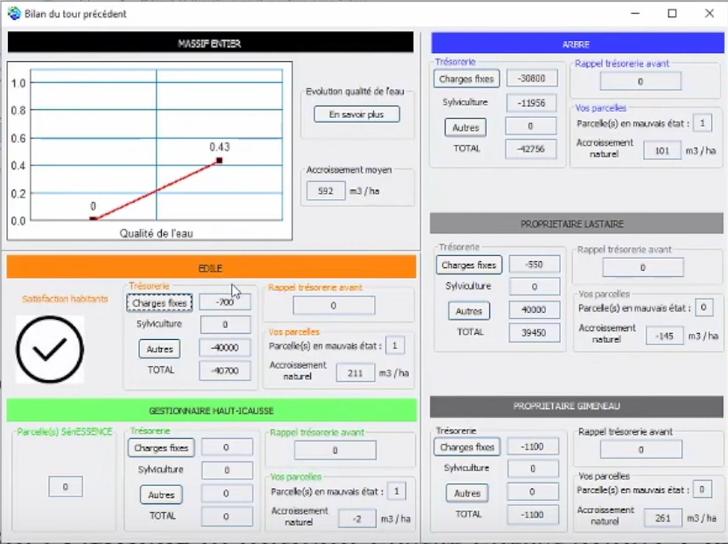
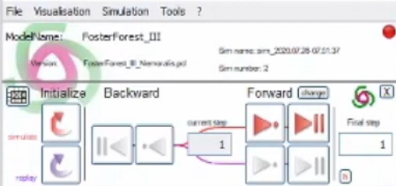
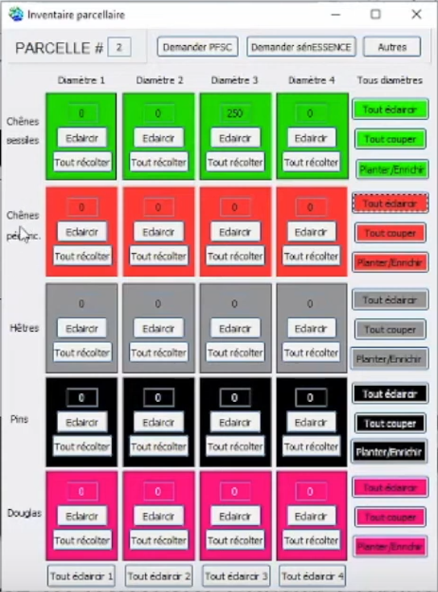
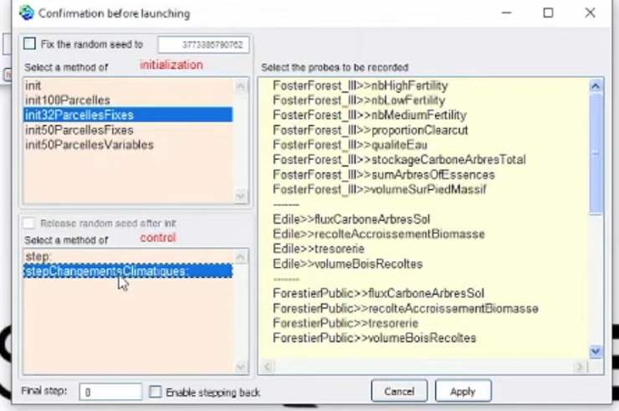
Related Work
FOSTER FOREST – Decision Making Aid
A 5 expert players + 1 facilitator, role-playing game that simulates forestry under changing climatic conditions.
PROS: ComMod, very engaging, realistic ecosystem model, rich variety of important scenarios (water quality upkeep, land use results, carbon sequestration, species conservation, etc.).
CONS: Very high learning curve (2 usage videos, 6 booklets). Very difficult to use with young or non-expert audiences. Need for elaborate set up (2 projectors + 1 expert facilitator), an expert facilitator, UI is not very user friendly, lacks feedback upon climate changes.
[8]

Slide 5
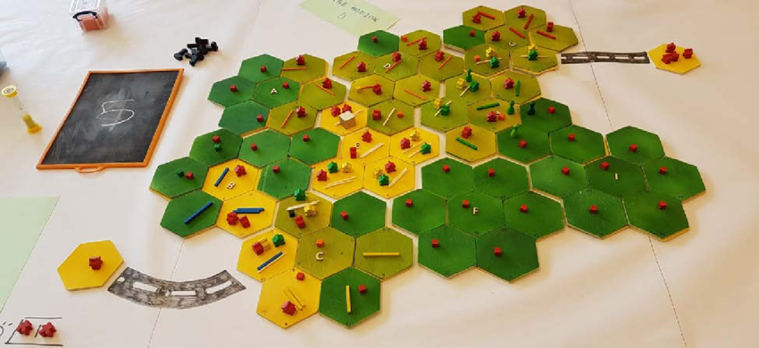
Related Work
In 2023, P. O. Waeber et. al. tried this game with Forestry graduate students online via a zoom call. THEY confirm good engagement, a great learning experience, and emergence of realistic strategies. There is a need for a fully digital version of this and/or similar games for use as widely accessible, effective, transformative learning tools. [10]
MINE SET – Educational Game
A role-playing board game where players act as CEOs of logging or mining companies and interact with markets, the government, and NGOs to develop strategies which alter land use as measured in terms of forest cover, biodiversity, and volumes traded. The underlying model captures all main drivers of land use change in central African forests (demographics, economical, governance, technological, cultural) via simple rules. [9]
PROS: ComMod, engaging, captures rich variety of land use change drivers, model progression, immersive.
CONS: Allegorical model, (not scientifically accurate), significant set up needed.

Slide 6
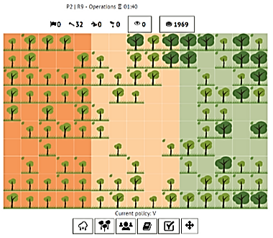
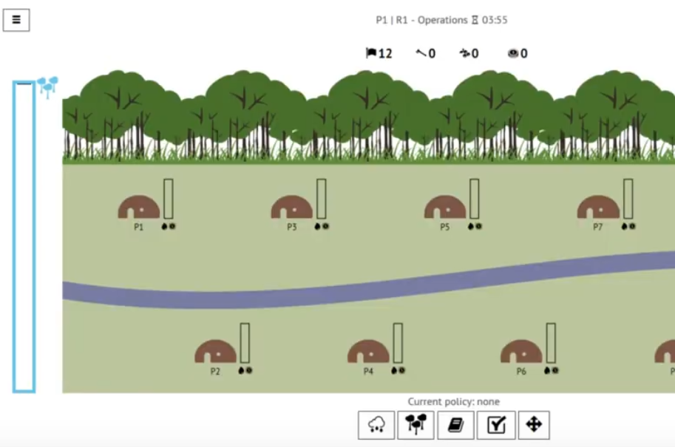
Related Work
ABOUT THAT FOREST – Educational Game
Web Based multi-player RPG where learners play as forest dwellers who draft and vote on policies to decide on harvesting trees or selling non-timber forest products to make money. Players can also plant new trees and monitor others. The environment reciprocates poor health of the forest via floods that lead to loss for all community members.
PROS: ComMod, engaging, competition v/s cooperation, Explores Economic Driver of Exploitation, widely accessible, appeals to a wider age group and range of starting knowledge level.
https://games4sustainability.org/gamepedia/about-that-forest/

Slide 7
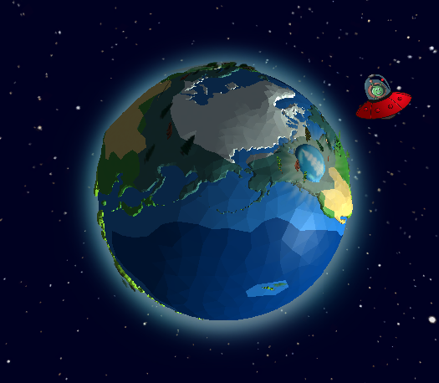
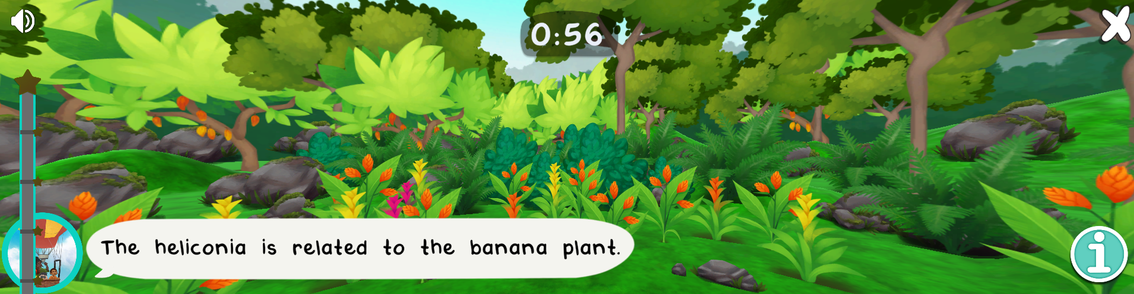
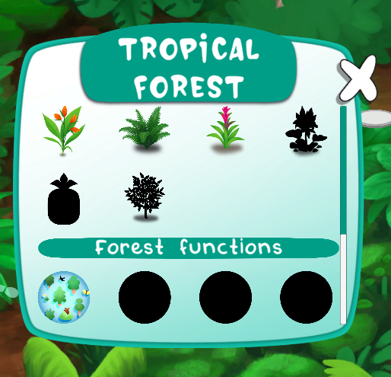
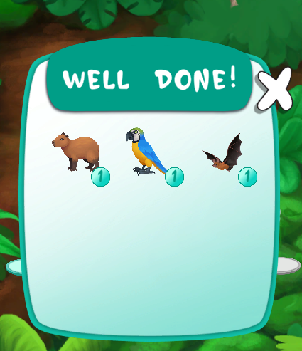
Related Work
FOREST KIDS – Educational Game
Web based game for children where they visit different types of forests and can discover various flora and fauna along with services that the forest offers. Contains fun mini games like picture matching and biodiversity spotting. Provides short fun facts. Learners earn points and can collect spotted species.
https://www.esa.int/Education/Forest_Kids_game_on_biodiversity_now_available
PROS: Very engaging, rich variety of activities, very user friendly, suitable for young children, lots of in-app help in small amounts, visually attractive.

Slide 8
Related Work
X
Not multiplayer but allows for team learning activities.
PRESENTED APP
EXISTING TOOLS
INFORMATIVE TOOL → QUALITY ↓ | FOSTER FOREST | MINE SET | ABOUT THAT FOREST | FOREST KIDS | MYCROFOREST
ENGAGING | ✔ | ✔ | ✔ | ✔ | ✔
FOR YOUTH | ✘ | ✔ | ✔ | ✘ | ✔
EASILY ACCESSIBLE | ✘ | ✘ | ✔ | ✔ | ✔
TEAM | ✔ | ✔ | ✔ | ✔ | ✘
SOLO | ✘ | ✘ | ✘ | ✔ | ✔
FOREST MANAGEMENT | ✔ | ✔ | ✔ | ✘ | ✔
FOREST AS CARBON SINK | ✔ | ✘ | ✘ | ✘ | ✔
FINANCIAL MOTIVE | ✔ | ✔ | ✔ | ✘ | ✔
LOW ENTRY THRESHOLD | ✘ | ✘ | ✔ | ✔ | ✔
EASY TO USE UI | ✘ | ✔ | ✔ | ✔ | ✔
SCIENTIFICALLY ACCURATE | ✔ | ✘ | ✘ | ✔ | ✘
SUFFICIENT BUILT IN HELP | ✘ | ✘ | ✔ | ✔ | ✔
SINGLE TARGET | ✘ | ✘ | ✔ | ✔ | ✔
✘
✘
Allegorical representation of carbon cycle and
real-world plant growth behaviour. Focus is on why. Not how.
X
Notes:
Mycroforest is the application that this project presents. There are multiple existing similar tools as listed along the top of the table here. Along the side of the table, are qualities that these other tools and Mycroforest is scored against. Many apps are very scientifically accurate decision-making tools like foster forest aimed at experts or adults. Mycroforest is not like this because the underlying conceptual model for teaching about forest management, need not capture plant growth and the carbon cycle in extreme detail. It is a simple, yet reflective model of the real world as is the case with others like mine set and about that forest. Mycroforest meets all intended criteria w.r.t this project. It is an engaging, easily accessible web-based application aimed at the youth. Although the app itself is not multiplayer, it allows for team learning activities in addition to individual ones. Unlike many existing tools that try to do multiple things at once, Mycroforest focuses exclusively on forest management, it's effect on atmospheric CO2 levels and the impact of financial motives. This app is built to be easy to get into and use with lots of built-in help. There is a slide for each of the 4 other apps which we can take a look at after this presentation, if you’d like that.

Slide 9
MycroForest - Educational Approach
Microworld → Good Engagement, Constructivist Thinking
Facilitator → Structure, Guidance, Inquiry Based Learning
Targets, Challenges → Structure, Problem Based Learning
Competition Among Teams → Gamification, Motivation
Debriefing → Reflective Learning, Inquiry Based Learning
Graphical Feedback + Short Explanations → High Effectiveness
Model Progression → Lowers Entry Threshold
[12] [13] [14] [15]
Notes:
Mycroforest is a microworld to promote learner engagement and constructivist thinking which have both been shown to improve learning. It's graphical feedback with short explanations should also improve learning effectiveness. Since microworlds have only been effective when some structure or guidance is provided, it's intended for this app to be used by students in the presence of a knowledgeable facilitator. The app allows for setting of targets around which structured learning activities may be developed via challenges that teams of students can race to overcome in a motivating, game like manner and can discuss about afterwards.

Slide 10
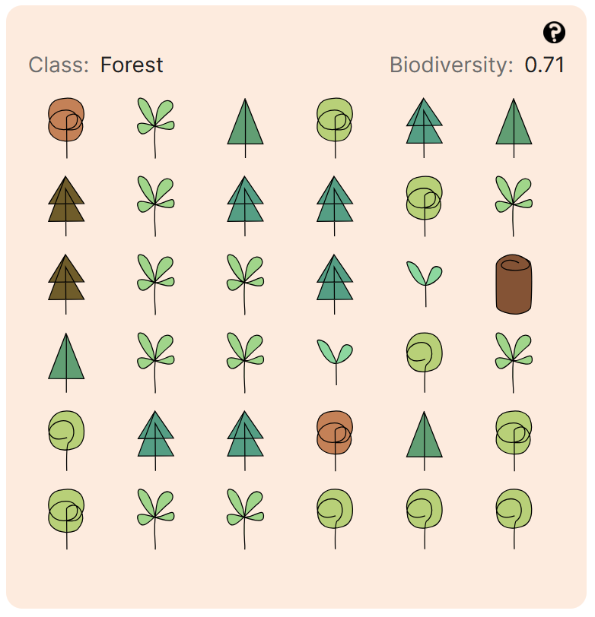
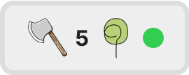
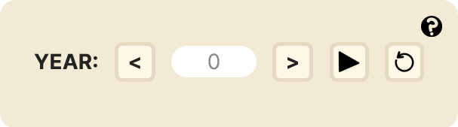
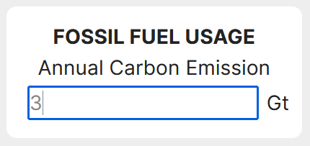
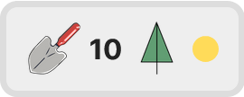
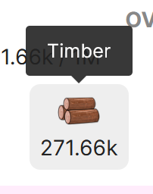
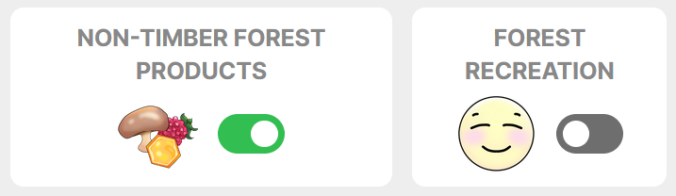

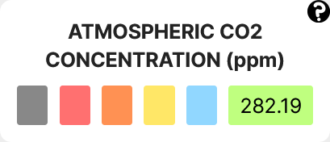
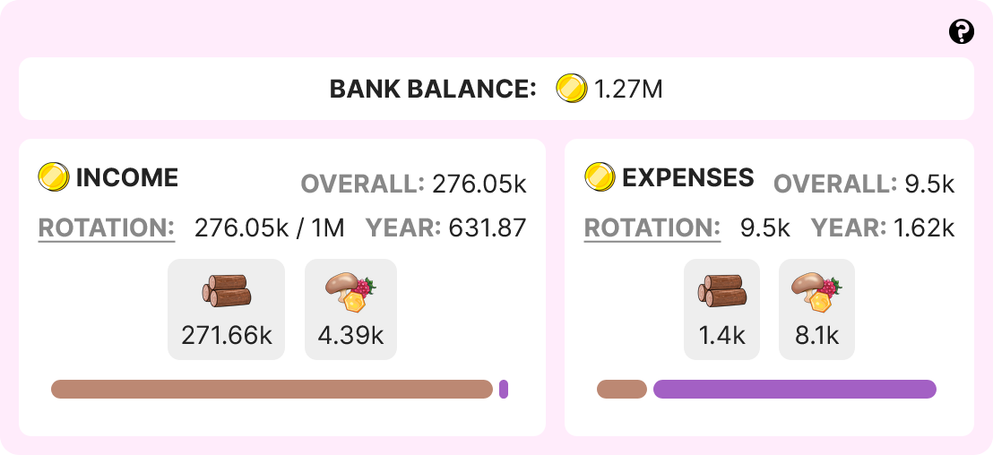
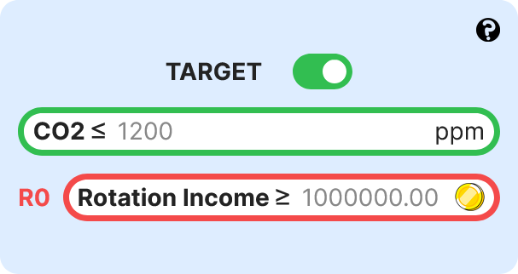
MycroForest – What’s Possible?
Move across time to see the plan in action.
Introduce emissions due to fossil fuel usage.
Plan frequency and timing of planting/felling trees.
Earn coins from selling wood/non-timber forest products and/or by opening the forest to public recreational use.
Get your personal forest with 2 types of trees at different stages in their life.
View atmospheric CO2 levels.
Set CO2 and income targets.
View income and expenses.
Notes:
Now, let’s explore what’s possible with the MycroForest app. To begin with, you receive your own forest with 2 species of trees at different stages in their lives. You may create forest management plans by deciding when and how often to plant or fell a tree. You can move across time using the timeline and view your plan in action. Chopped trees are sold for timber and this fetches income in coins. You can also earn through other income streams like by selling non-timber forest products of by opening the forest up for public recreational use. You can also introduce emissions due to fossil fuel usage. You may view your back balance, expenses and income as well as atmospheric CO2 levels that change over time. Finally, the target setter allows for you to set CO2 and income targets and shows whether you’ve met them.

Slide 11
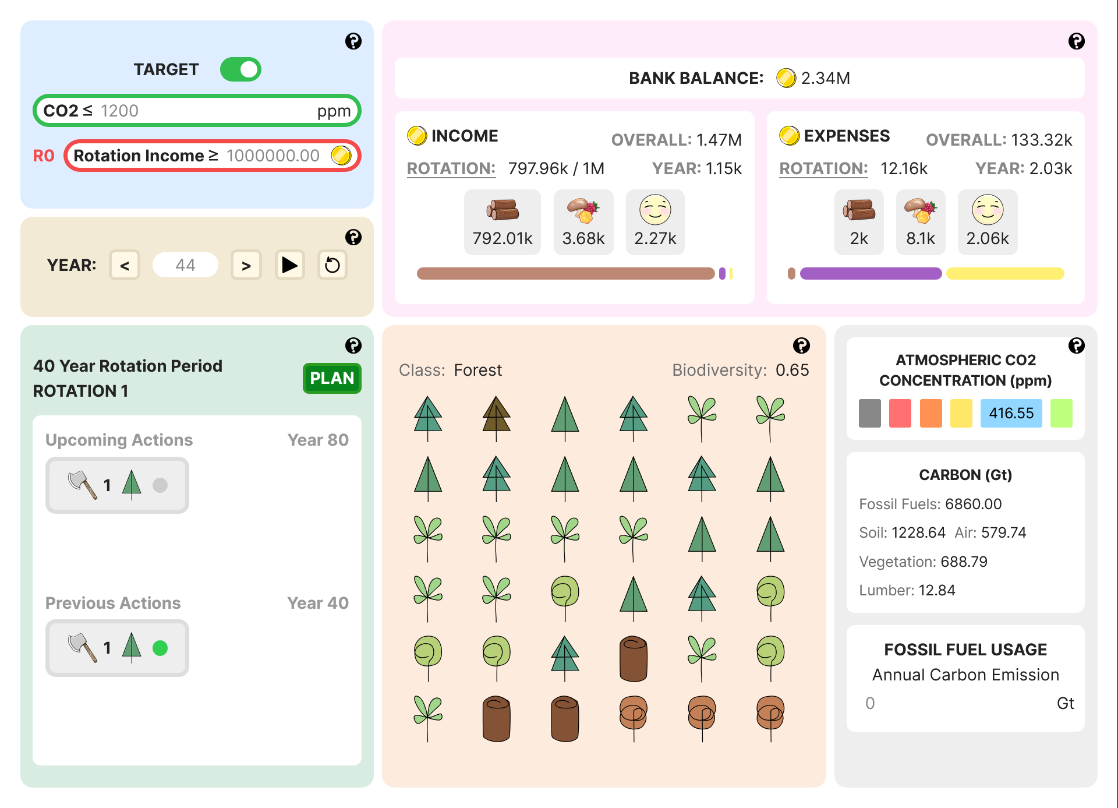
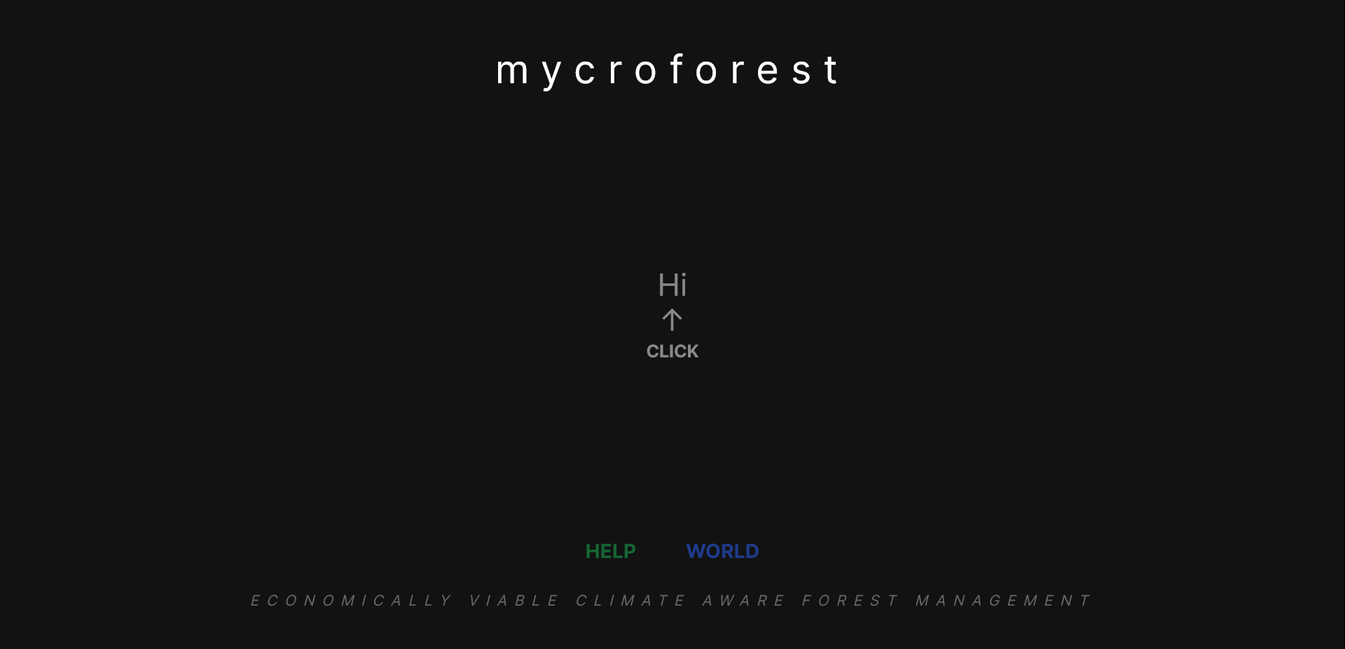
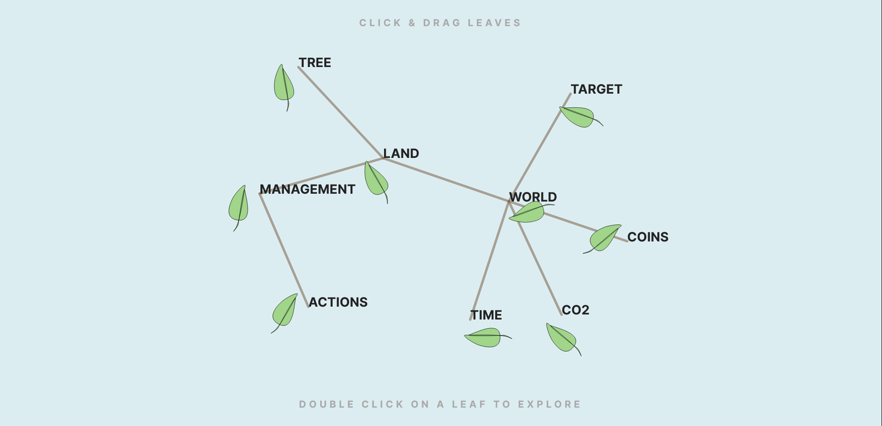
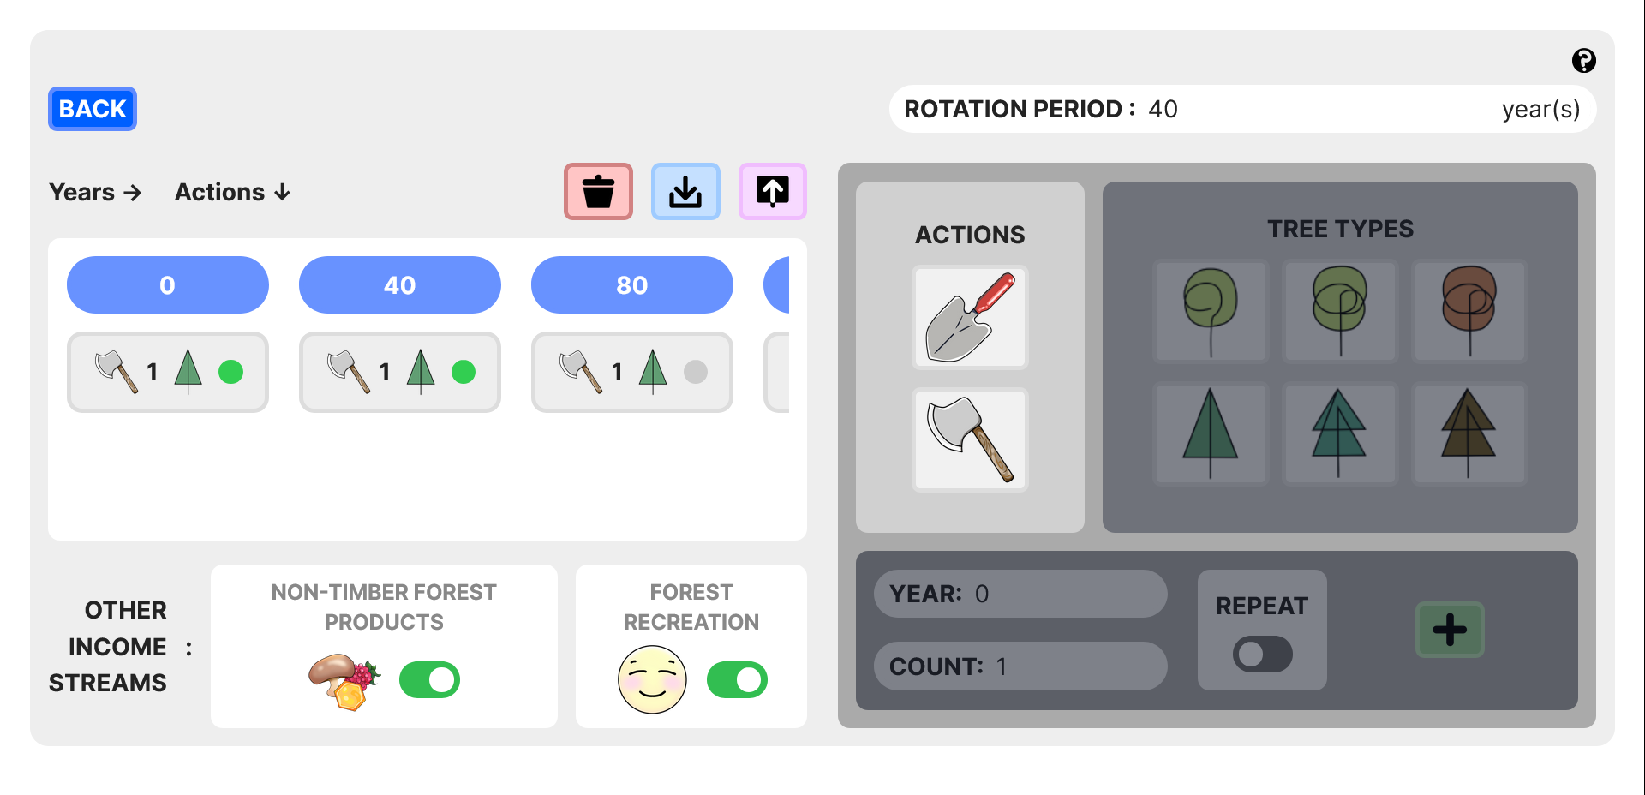
Design
CURRENT APP
UI COMPONENTS
LANDING HELP WORLD PLANNER
HOME
HOME
HOME
APP PAGES
SIMULATION MODEL
INPUT VARIABLES
UTILS
Notes:
Under the hood, the app can be thought of as being composed of a simulation, UI components, and input variables along with some utilities functions that are accessible from all project files. There are 4 pages that users may visit. The landing page is the first thing the learner sees. It's got a short introduction that the user can click through. Pressing H will reveal a help page with all the components of the world, what they mean and how to use them. Pressing the W key will take the learner to the main world page where the plan button can be used to view the planner page through which management plans can be created.

Slide 12
Design
SOME CHANGES OVER TIME
Notes:
From conception to fulfilment, the design and idea for this app have been though multiple changes. The next 3 slides will show 3 designs along the way.

Slide 13
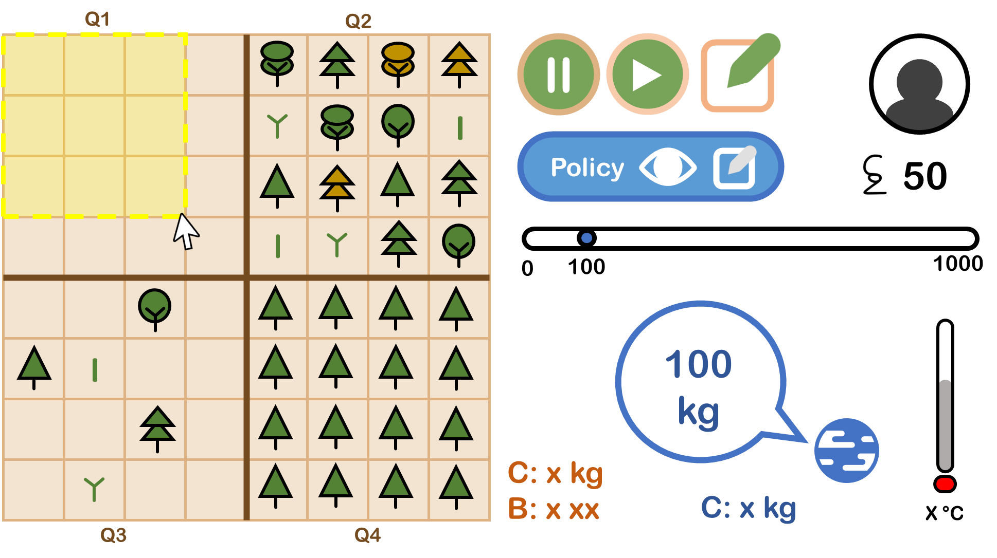
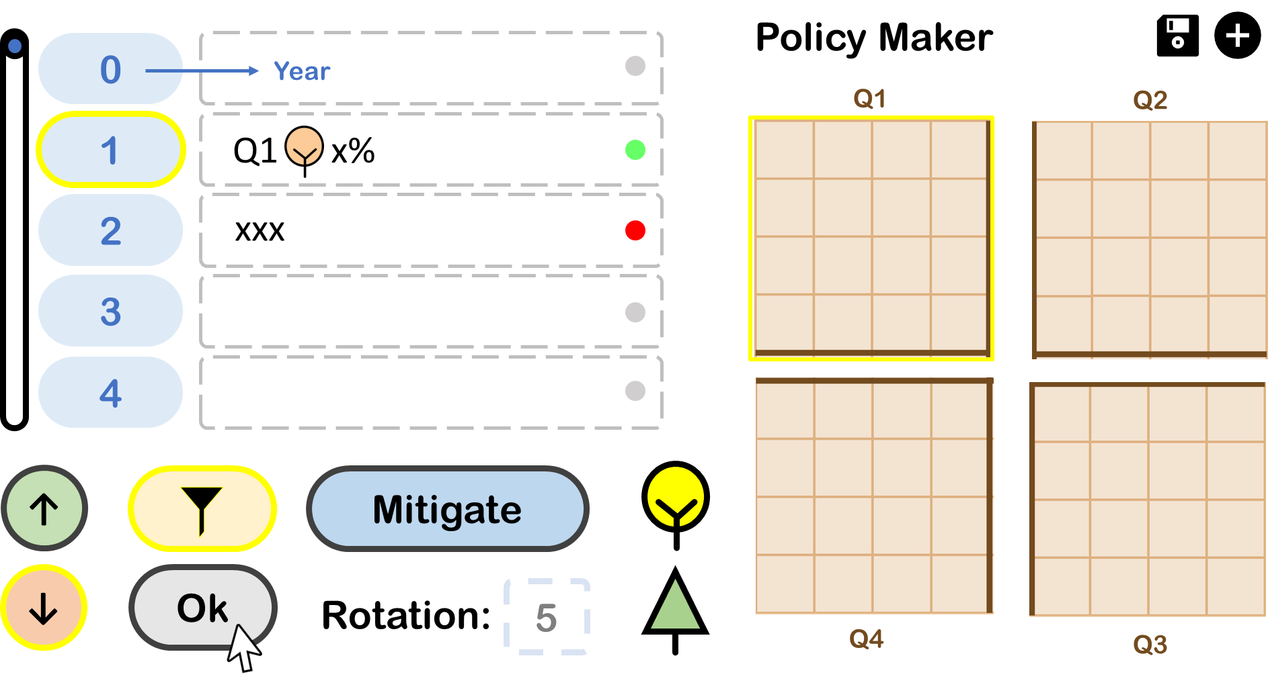
Design
MOCKUP 1
(MS Power Point)
Notes:
This was the first power point mockup of the app. It was much more cluttered compared to the current app and had a less intuitive way of capturing amount of wood harvested.

Slide 14
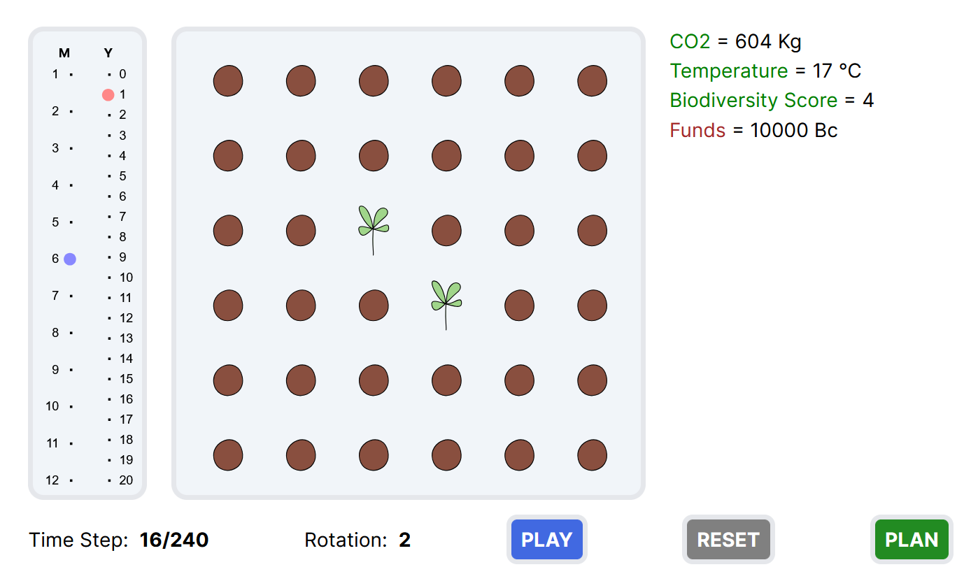
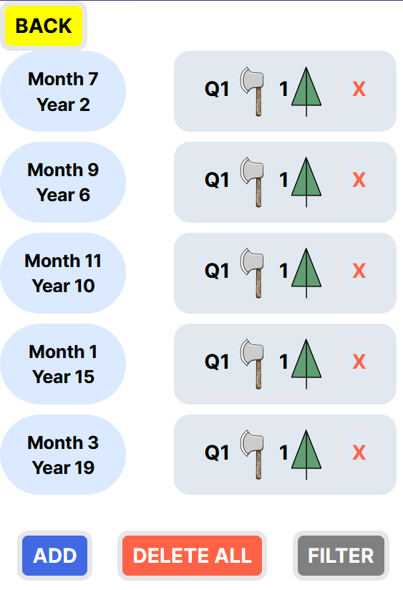
Design
PROTOTYPE 1 (Web)
Notes:
This was the first working web version of the app. It was built to experiment with graphical representation of tree growth and to judge feasibility of use of selected technology.

Slide 15

Design
https://www.figma.com/proto/Wmpkm80wpOe5lTfVKL0B9V/Mockup?node-id=0-1&t=R0TNsFjvVC2MEEUk-1
MOCKUP 2 (Figma)
Notes:
This was the last animated prototype with all features built using the Figma platform. It was based on this, that the final app was built.

Slide 16
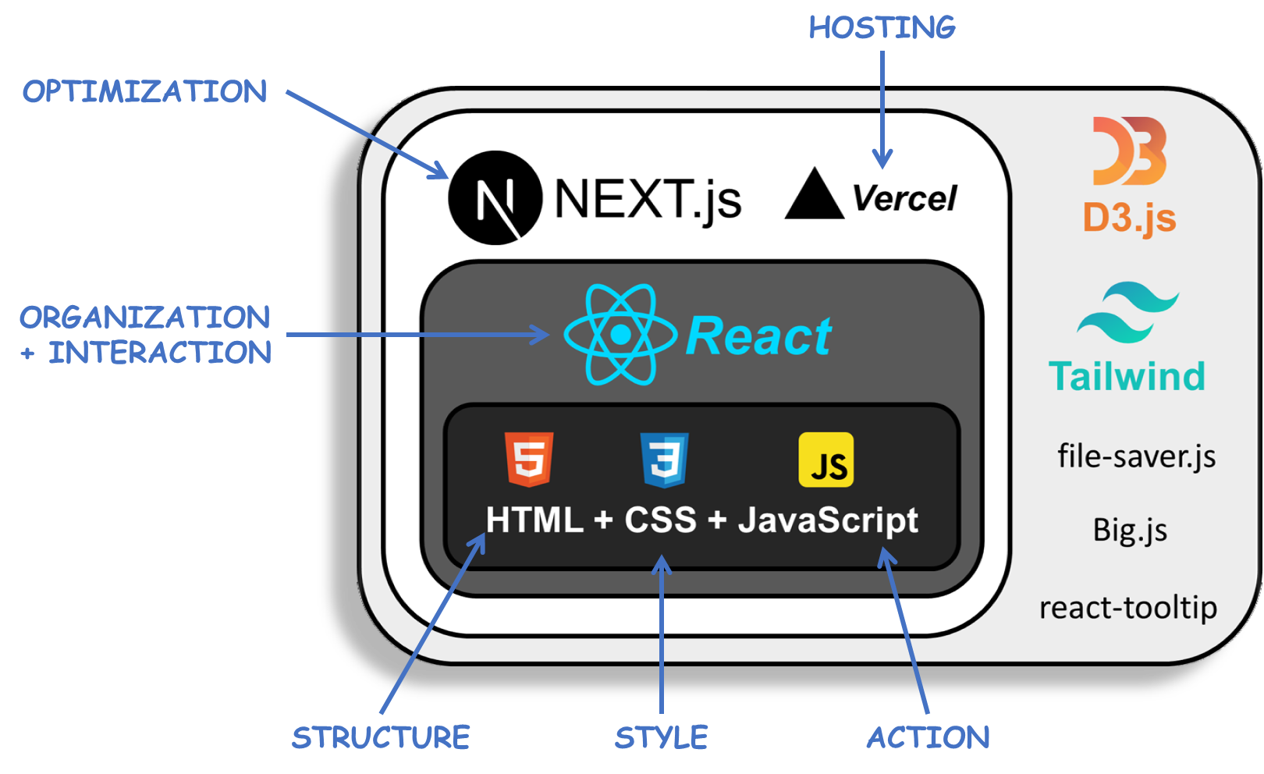
Design
TECHNICAL ARCHITECTURE
Notes:
Here we move on to how the app was built.
It used the NextJS framework. Next.js is a React framework that enables optimized server-side rendering, static site generation, and simplified routing for building web applications fast. Vercel is a cloud platform where web apps can be deployed. It was created by the creators of NextJS and hence the two are very compatible. Mycroforest is currently hosted on Vercel.
Moving a layer deeper, ReactJS is a JavaScript library for building user interfaces. It allows creation of reusable UI components and easy state management via efficient virtual DOM manipulation. This framework is especially suitable for applications with heavy user interaction as is the case here.
At the core is HTML, CSS and JavaScipt. The trinity that the web is built upon with HTML providing structure, CSS adding style and JavaScipt bringing dynamics. Everything else exists to make development using these primary languages easier.
Towards the side, are listed libraries/frameworks that further enhance or simplify development. D3.js is a graphics library that allows for custom plots. In the app this was used to create the piece of land where trees grow and change shape. This is essentially a fancy scatter plot. Tailwind CSS is a framework that integrates CSS into HTML for ease. The file-saver.js library was used to allow user plans to be saved or loaded. The Big.js library helped overcome the challenge of precision loss when working with astronomically large numbers and the react-tooltip library provides a ready-made tooltip component that is otherwise cumbersome to create.

Slide 17
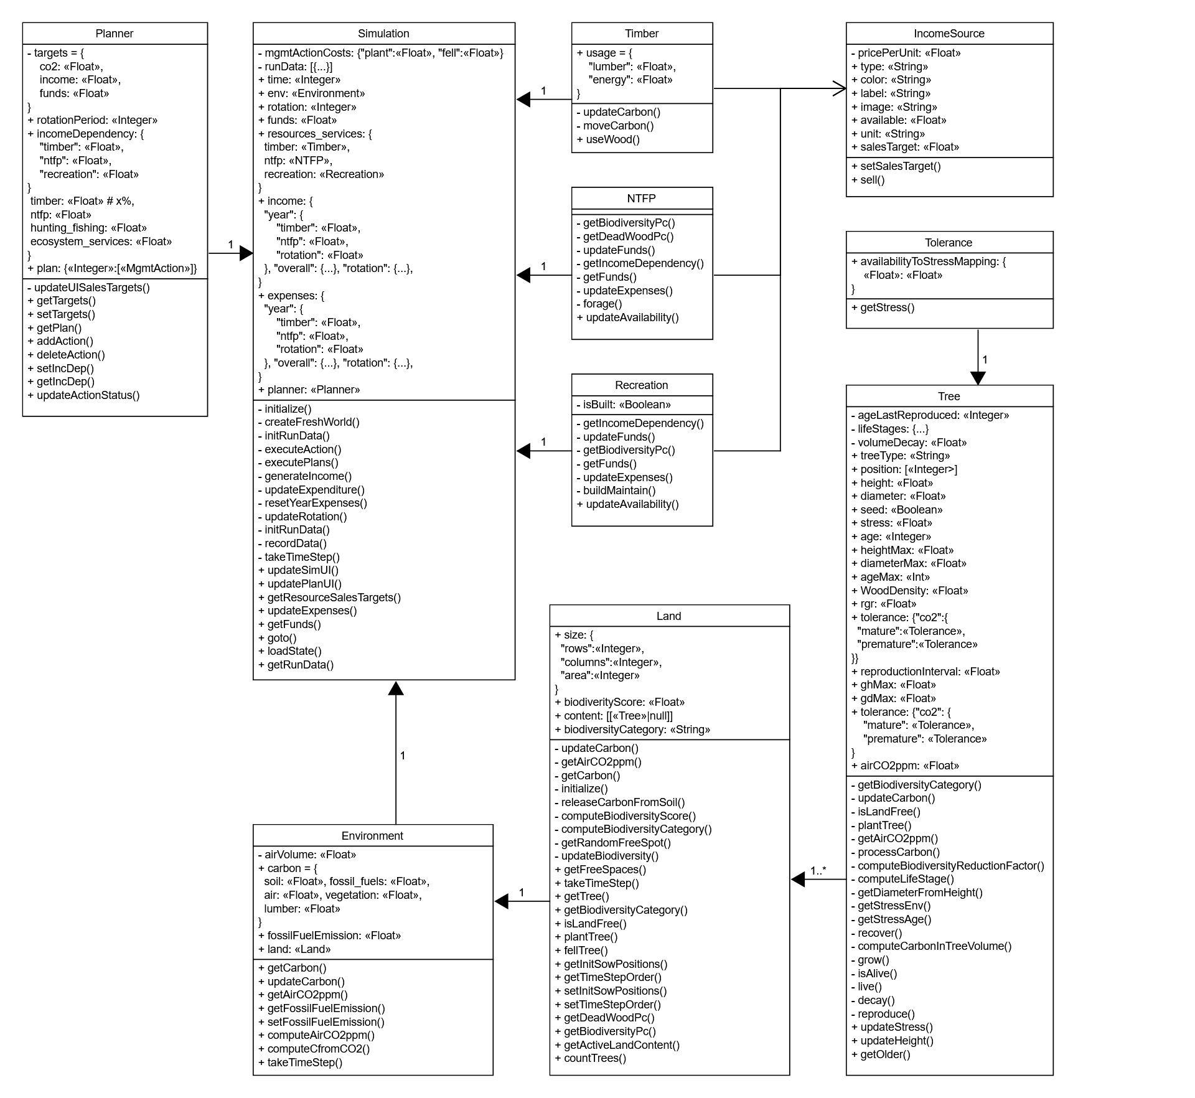
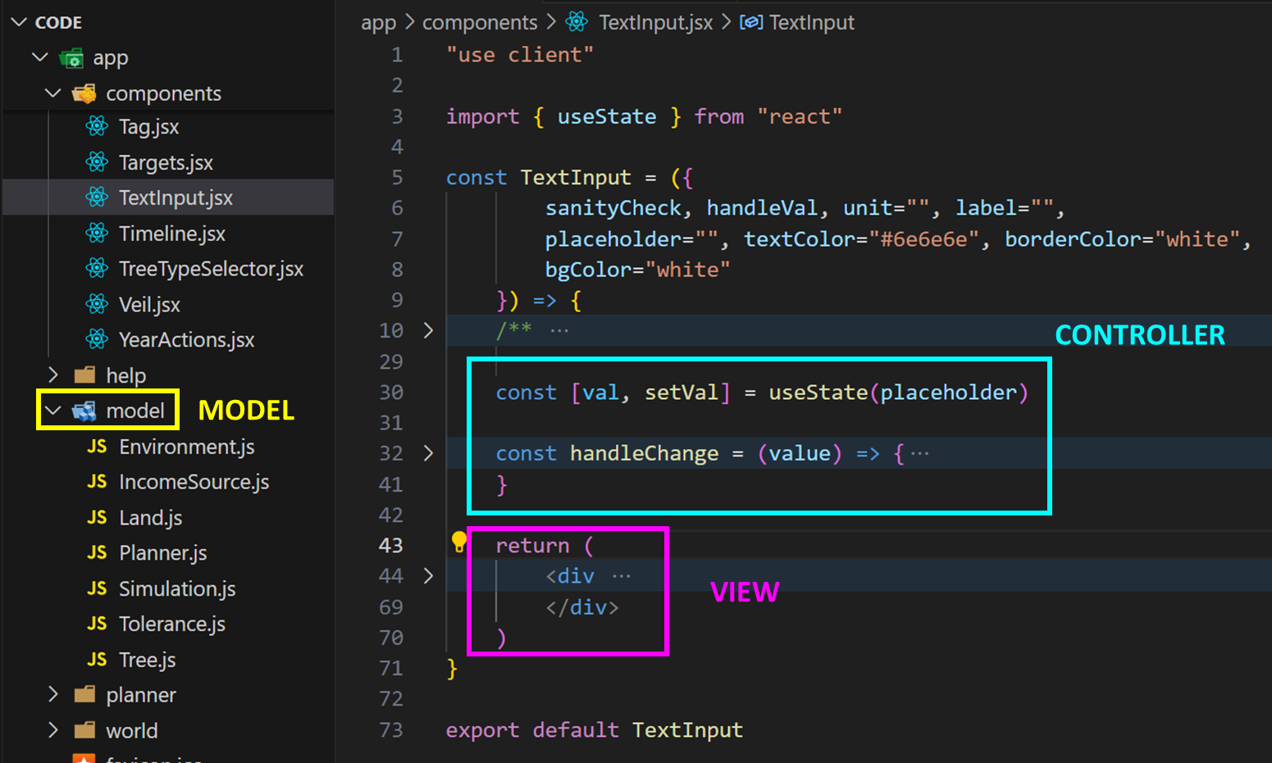
Design
AVOIDING COMMON PITFALLS
BAD DESIGN ELEMENT |  | COUNTER MEASURES TAKEN
RIGIDITY | Difficult to change. | Separation of concerns by sticking to the Model View Controller design pattern. Underlying model is separate from React components and is organized into in an Object Oriented Fashion.
FRAGILITY | Prone to breaking. | Modular testing (app and specific components tested immediately after implementation of each new feature). GitHub for version control. Lessen rigidity.
IMMOBILITY | Difficult to reuse. | Choice to use ReactJS allows for creation of reusable components. Example: <Button/>, <Switch/>, <Card/>, <Veil/>, etc.
VISCOSITY | Hacks over the right thing. | Temporary fixes were avoided or immediately replaced as soon as correct solution was identified. Example: Decision to change structure of code early on and start afresh instead of continuing work on initial prototype code.
Model View Controller
classes
Notes:
Bad code has the following 4 defining characteristics. It is difficult to change, prone to breaking, difficult to reuse, and contains hacks instead of appropriate fixes. While developing Mycroforest, measures have been taken to prevent such consequences of bad design. The code adheres to the model view controller design pattern and the underlying model is organized in an object oriented fashion. The web pages are composed of reusable React components and temporary fixes were avoided.
This is a glimpse of the Model View Controller separation in code. The model captures simulation logic and rules while the view is what the user sees. In react, this would be the JavaScript XML that is returned. The code above the return statement in each component can be considered as the controller, which is the intermediary between the model and the view.
This is a quick look at the UML class diagram that captures the simulation model.

Slide 18
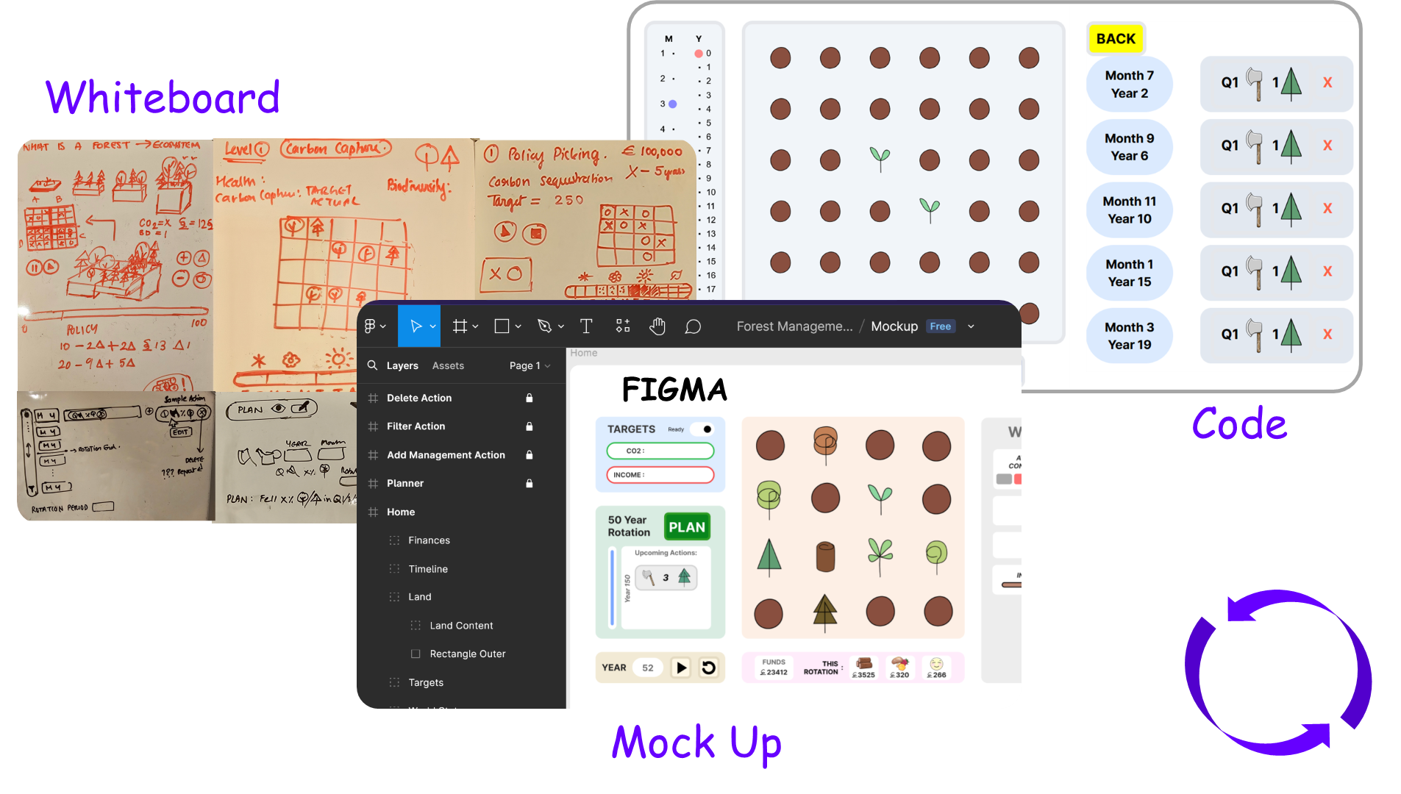
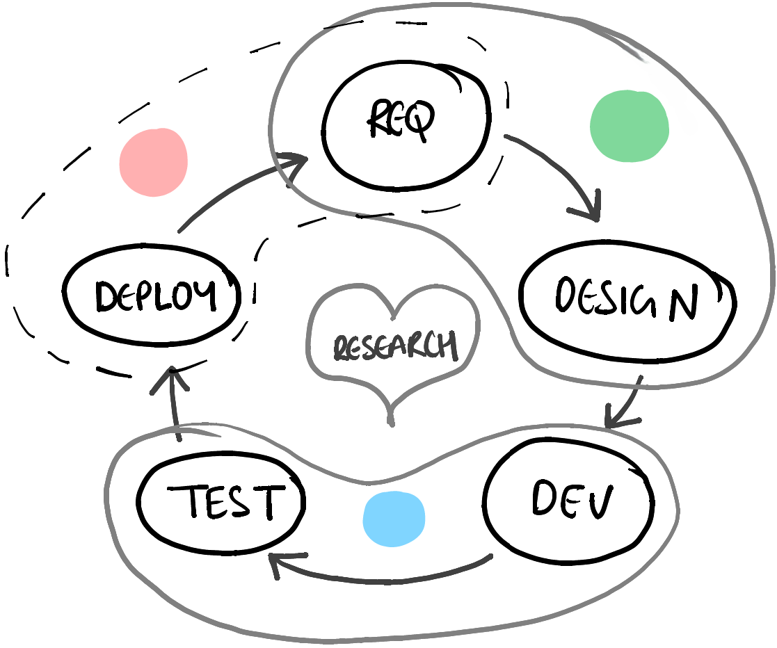
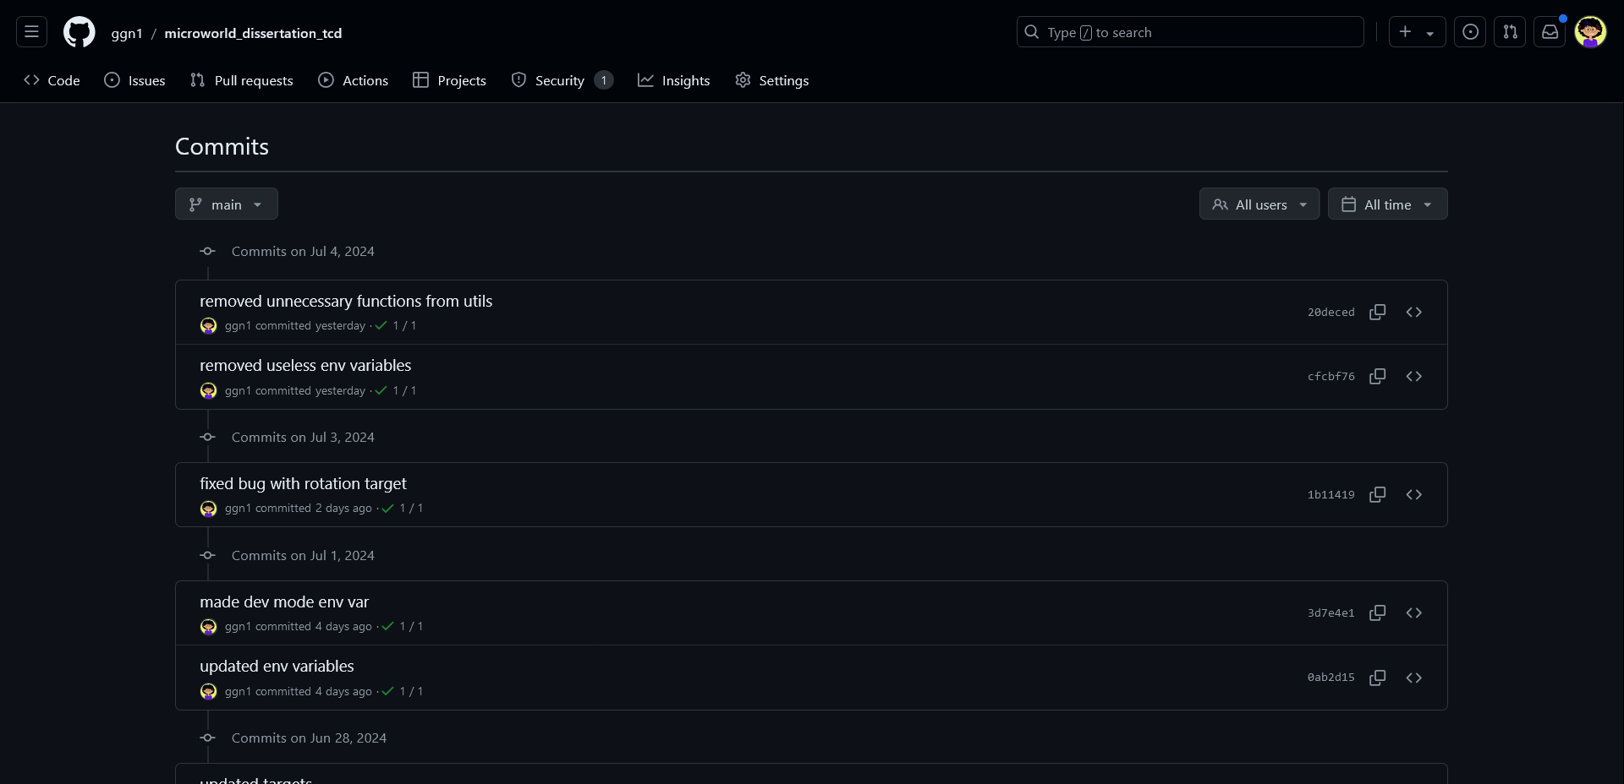
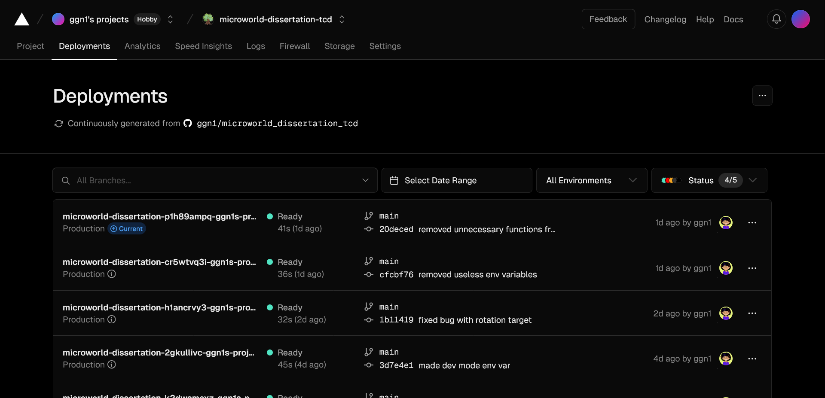
Design
STAYING AGILE
Deployment
& Analysis
Planning
Iterative Development
Frequent Feature Delivery
Building
CICD Pipeline Set Up using &
GitHub
Vercel
Notes:
The development itself followed an Agile management strategy. It was an iterative process comprising 3 broad stages namely planning, building and deployment with research conducted as and where required.
Typically, an iteration would involve a whiteboarding phase followed by more concrete visualization and then coding.
This allowed for frequent delivery of features. Features to be implemented were broken down into small parts and added to a list somewhat like a product backlog and was checked off after implementation and testing.
GitHub was used for version control and it was linked to Vercel to set up the continuous integration and continuous development pipeline. Every time a new feature is pushed to GitHub, it a new version of the app incorporating this change is deployed.

Slide 19
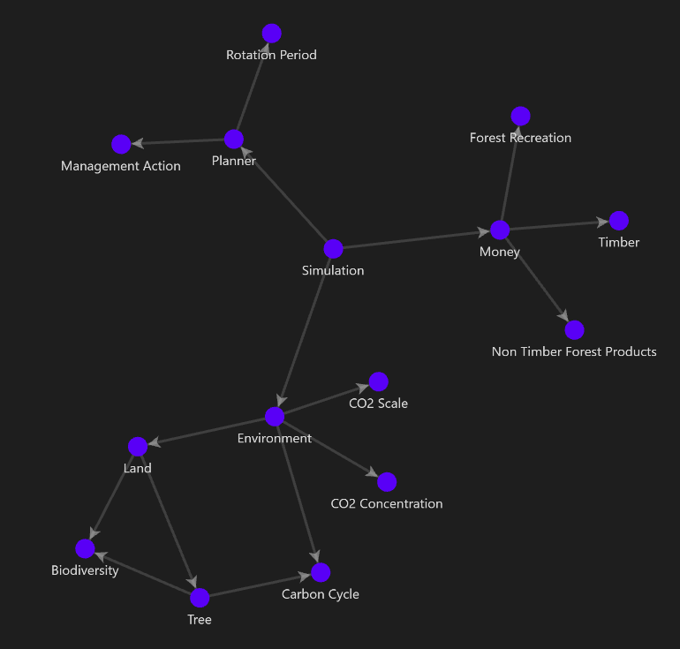
Design
SOME PROJECT-SPECIFIC CHALLENGES
PROBLEM: Precision issues when working with astronomically large numbers.
SOLUTION: Big.js library.
PROBLEM: Integrating D3.js v7 with NextJS technologies.
SOLUTION: Research + documentation + trial an error.
PROBLEM: Rigidity of software. Difficult to change.
SOLUTION: Move key variables to a separate environment file. Enforce Model View Controller design pattern.
PROBLEM: Getting the carbon cycle to keep CO2 concentration levels in balance.
SOLUTION: Consult co-supervisor. Research to arrive at real world numbers and maintaining ratios.
PROBLEM: Global values must be influenced by absorption and release from only 36 trees.
SOLUTION: Scale carbon absorbed and released by a fixed factor. Find right value through trial and error.
PROBLEM: Difficult to keep track of all model rules and design choices.
SOLUTION: Organize documentation corresponding to each interconnected component in graph format. I used to do this.
Obsidian
Notes:
This slide presents some problems faced and solutions identified. For example, a simple, but important problem was that of organizing all data and rules that make up the simulation model. A good solution was to use network-based file management for which a Software called Obsidian was used. Each node in this image representing a key component or idea within the model, is a file and the connections show how these elements fit in with others.

Slide 20
Demo
https://microworld-dissertation-tcd.vercel.app/
Notes:
Now, let's check out the deployed app. The best way to get a feel for it is to go over a quick challenge as students would.

Slide 21
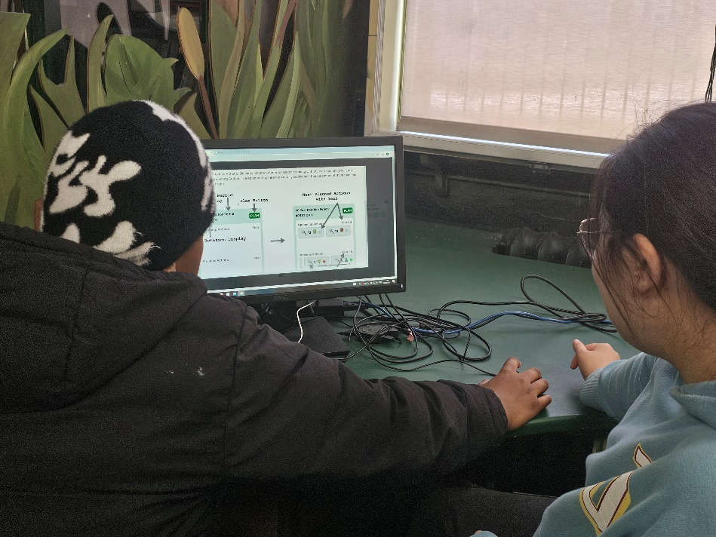
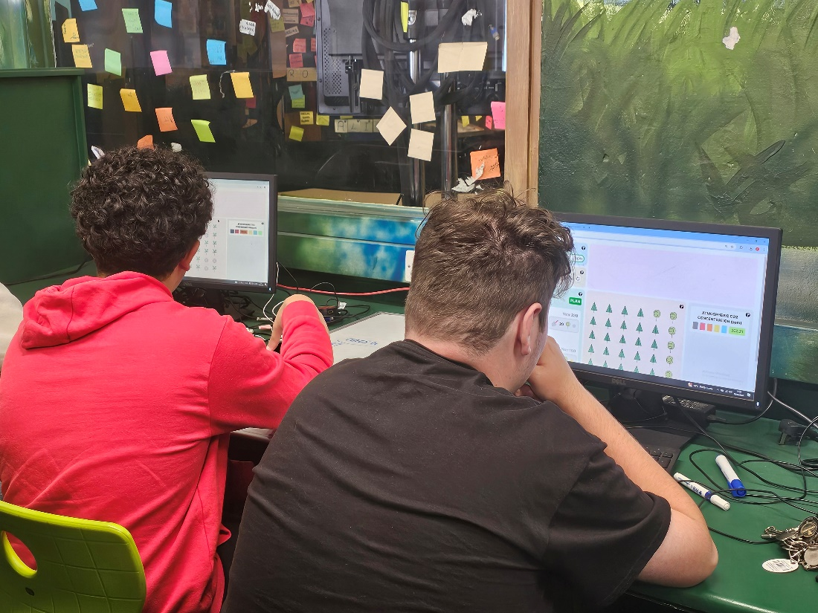
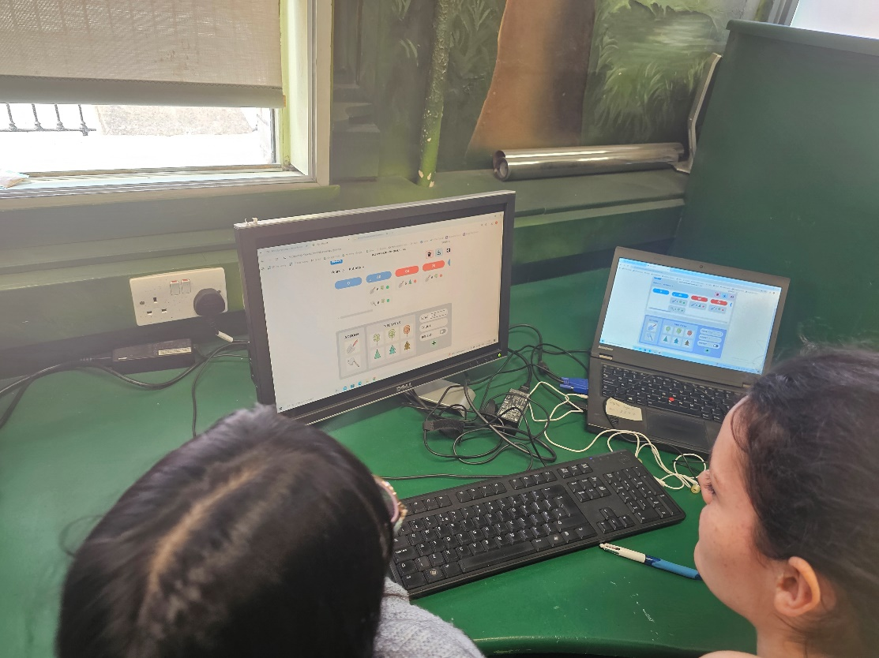
Evaluation
BRIDGE TO COLLEGE LEARNING SESSION
The Mycroforest teaching tool was used for a 2-hour session with (n=10) Transition Year students on the TAP Bridge2College Programme.
Learning Activity:
Introduction (explanation by tutors and a short video).
Challenge 1 – Maximize income.
Discussion.
Challenge 2 – Maximize carbon capture.
Discussion.
Questionnaire – UIUX (PSSUQ), educational experience, attitude towards climate change.
Notes:
The Mycroforest teaching tool was used for a 2-hour session with (n=10) Transition Year students on the TAP Bridge2College Programme. The session began with a quick introduction followed by 2 challenges, each one followed by a discussion. A questionnaire with questions on user experience, educational value, and attitude towards climate change marked the end of activities.

Slide 22




Evaluation Results
LARGELY POSITIVE
“Lower CO2” “Effect of trees.” “Comp Science can mix with forestry.” “Sustainable way doesn't necessarily affect profits.” “Important to manage forests to do what’s best for the environment” “Forests are important.” “Balance CO2 with money.” “Research for a good plan to keep CO2 low enough and make money at the same time.” “Manage CO2 emissions.” “Try to find the perfect middle ground and think about our world.” “Plan and manage the forest to make money while keeping CO2 levels low.” “Think about my life decisions.”
BRIDGE TO COLLEGE LEARNING SESSION
“No error messages.”
“Fun”
“Simple”
“Easy to use.”
“Add different
scenarios”
“Clearly showed us how forestry
affects CO2 emissions.”
“Info hard to find.”
“Very Informative”
“Make how years and rotation period works clearer.”
“How forestry works.”
Domain Expert: “Students stumbled upon 2 existing management strategies: Clear Felling & Thinning.”
TAKEAWAYS
Notes:
Most students had positive comments. They appreciate the ease of use and information presented. They suggest that more scenarios be included and that help be more clear. The Botany professor present at the event, a domain expert pointed out how the students had discovered for themselves, two existing forest management strategies, "clear felling" and "thinning".
Overall, from what the students reported, they left the experience with greater awareness and appreciation regarding the need to reduce CO2 in the air, manage forests sustainably, and the need to find a middle ground between economic gains and health of the planet.

Slide 23
What did I learn?
URGENCY OF NEED FOR ACTION AGAINST RAPID CLIMATE CHANGE
FORESTY PRACTICES, INCOME STREAMS, AND ROLE OF FORESTS AS CARBON SINKS
FEATURES OF EFFECTIVE EDUCATIONAL TOOLS
JOY OF SHARING KNOWLEDGE
OBJECT ORIENTED PROGRAMMING IN JAVASCRIPT
IMPORTANCE OF DOCUMENTATION & SOFTWARE DEVELOPMENT BEST PRACTICES
ADVANTAGE OF AGILE DEVELOPMENT METHODOLOGY
APP EVALUATION
ANOTHER CHANCE TO APPLY CONCEPTS FROM THE ADVANCED SOFTWARE ENGINEERING MODULE
Notes:
Throughout this project. I have also learned a lot about forestry and what goes into creating an effective learning application. I've also furthered my web development skills and got to employ concepts learned in my Advanced Software Engineering module during development. It was most exciting to have real users use and evaluate the application.

Slide 24
Conclusion
ACHIEVEMENTS & LIMITATIONS
ACHIEVEMENTS | LIMITATIONS
A functional teaching tool that students found informative, fun, and simple to use. Applied S/W development theory. Experienced product evaluation process. Learned about effective teaching and forests Better appreciation for the natural world. Furthered Web Dev and Research skills. | App’s help was less clear at times. Model can be more stable. Evaluation consisted of just 10 learners. This is not statistically significant as n < 30.
Notes:
Overall, I am satisfied about how this project has led to the development of a functional teaching tool that students and teachers valued. I am happy to have furthered my research and web development skills and am grateful for the opportunity to help impart knowledge. A key limitation of the evaluation was that it was only possible to have 10 students try the app so far. Nevertheless, it's good to know they found it informative. An extension of this work could involve further stabilizing the simulation and to investigate the value in making it more accurate. Also, a built-in interactive tutorial could be developed to help users get a feel for the tool quicker. The tool may also be extended to include more income streams like agroforestry and management actions around disease prevention, fertilization, watering, etc.

Slide 25
Thank You

Slide 26
References
[1] Adam Daigneault et. al., “How the future of the global forest sink depends on timber demand, forest management, and carbon policies,” Global Environmental Change Human and Policy Dimensions, 2022. 76., vol. 76, p. 1–13, 2022.
[2] J. Fergesen, “Trees Help Protect the Planet From Climate Change. But The World Isn’t Doing Enough to Protect Forests,” TIME, 18 October 2022. [Online]. Available: https://time.com/6213444/how-do-trees-affect-climate-change/. [Accessed 25 June 2024].
[3] C. Anders, “World breaks 1,400 temperature records in a week as heat waves sweep globe,” semafor, 23 June 2024. [Online]. Available: https://www.semafor.com/article/06/23/2024/world-breaks-1400-temperature-records-heat-waves-sweep-globe. [Accessed 25 June 2024]
[4] Times Of India, “India records highest temperature with Rajasthan’s Phalodi at 50 degrees; red alert issued for these states” 27 May 2024. [Online]. Available: https://timesofindia.indiatimes.com/travel/travel-news/india-records-highest-temperature-with-rajasthans-phalodi-at-50-degrees-red-alert-issued-for-these-states/articleshow/110438133.cms. [Accessed 5 July 2024].

Slide 27
References
[5] European Commission, “Consequences of climate change,” European Commission, [Online]. Available: https://climate.ec.europa.eu/climate-change/consequences-climate-change_en#threats-to-business. [Accessed 25 June 2024].
[6] A. Moseman, “What is the ideal level of carbon dioxide in the atmosphere for human life?,” Climate Portal MIT, 18 May 2021. [Online]. Available: https://climate.mit.edu/ask-mit/what-ideal-level-carbon-dioxide-atmosphere-human-life. [Accessed 25 June 2024].
[7] Myles Allen et. al., “Frequently Asked Questions,” Intergovernmental Panel on Climate Change (IPCC), 2018. [Online]. Available: https://www.ipcc.ch/site/assets/uploads/sites/2/2018/12/SR15_FAQ_Low_Res.pdf. [Accessed 25 June 2024].
[8] T. Fouqueray, J. Latune, M. Trommetter and N. Frascaria-Lacoste. Interdisciplinary modeling and participatory simulation of forest management to foster adaptation to climate change. Environmental Modelling &amp; Software 2022 Vol. 151 Pages 105338.DOI: 10.1016/j.envsoft.2022.105338. https://dx.doi.org/10.1016/j.envsoft.2022.105338

Slide 28
References
[9] C. Garcia and E. Speelman. 2017. Landscape Approaches, Wicked Problems and Role Playing Games. DOI: 10.13140/RG.2.2.26134.24644. https://www.researchgate.net/publication/320170969_Landscape_Approaches_Wicked_Problems_and_Role_Playing_Games.
[10] P. O. Waeber, M. Melnykovych, E. Riegel, L. V. Chongong, R. Lloren, J. Raher, et al. Institution: MDPI AG 2023. Fostering Innovation, Transition, and Reconstruction of Forestry: Critical Thinking and Transdisciplinarity in Forest Education with Strategy Games. DOI: 10.20944/preprints202305.1718.v1. https://dx.doi.org/10.20944/preprints202305.1718.v1
[11] Myles Allen et. al., “Frequently Asked Questions,” Intergovernmental Panel on Climate Change (IPCC), 2018. [Online]. Available: https://www.ipcc.ch/site/assets/uploads/sites/2/2018/12/SR15_FAQ_Low_Res.pdf. [Accessed 25 June 2024].
[12] C. Hoyles, R. Noss and R. Adamson. 2002. Rethinking the Microworld Idea. Journal of Educational Computing Research Vol. 27 Issue 1 Pages 29-53. DOI: 10.2190/u6x9-0m6h-mu1q-v36x. https://journals.sagepub.com/doi/abs/10.2190/U6X9-0M6H-MU1Q-V36X

Slide 29
References
[13] L. P. Rieber. Cambridge Handbook of Multimedia Learning 2005. Multimedia Learning in Games, Simulations, and Microworlds. http://lrieber.coe.uga.edu/mayer2005/
[14] S. Dabholkar. Northwestern University Ph.D. 2021. Restructurating Science Learning with Emergent Systems Microworld (ESM)-based Learning Environments. https://www.proquest.com/docview/2618538356?pq-origsite=gscholar&fromopenview=true&sourcetype=Dissertations%20&%20Theses
[15] G. K. Lilian. Education for Sustainable Development Pedagogy in Pre-Primary Social Studies Curriculum in Kenya: Review of Literature. Journal La Edusci 2022 Vol. 3 Issue 3 Pages 1-12. DOI: 10.37899/journallaedusci.v3i3.662, https://dx.doi.org/10.37899/journallaedusci.v3i3.662

